Slide 1



Big Data Seminar – BIA 678
David Belanger PhD
Senior Research Fellow – Stevens Institute of Technology
dbelange@stevens.edu
http://www.examiner.com/images/blog/EXID1827/images/shamrock.jpg

Slide 2
Class 11 – Analytics I– Outline Occam’s Razor “Everything Should Be As Simple As Possible, But Not Simpler” – Albert Einstein
Administrative Stuff:
Term Papers Mostly Submitted
Team Project Questions
Activity #1 – Check on Term Paper Success and/or Questions
Activity #2 – Questions on Recommenders
Activity #2 – Ensemble Classifiers
Readings for Next Week:
https://www.isaca.org/chapters3/Atlanta/AboutOurChapter/Documents/GW2014/Implementing%20a%20Data%20Governance%20Program%20-%20Chalker%202014.pdf
Thomas Wedell-Wedellsborg, Are You Solving the Right Problems, Harvard Business Review, Jan-Feb 2017 - On CANVAS
Source #1 - www.tableau.com/academic

Slide 3
Class 9 Looking Ahead
Analytics:
http://www.di.unipi.it/~cardillo/AA0304/fabio/boosting.pdf
Visualization (Next Week):
Shneiderman, Ben, Extreme Visualization: Squeezing a Billion Records into a Million Pixels http://www.cs.umd.edu/~ben/papers/Shneiderman2008Extreme.pdf
Nanocubes for Real-Time Exploration of Spatiotemporal Datasets Lauro Lins, James T. Klosowski, and Carlos Scheidegger; http://nanocubes.net/assets/pdf/nanocubes_paper.pdf , + http://www.nanocubes.net/ for demos and open source.
Extra Credit:
http://grouplens.org/datasets/movielens/ - Do a SVD Recommender for the smaller dataset, using Python or Java or R.

Slide 4
Impact of Scale: A Example of Classification Performance Results #3 Study by: Prashanth Ashok Ramkumar, Ram Kharawala, Qing Wei

Slide 5
So What Can One Do About Scale?
Data in Flight:
Shannon’s Law
Compression – lossy or lossless
Parallelization
Distribution – Move the Data Less
Move Processing to Data
Data at Rest:
Compression
Parallelization
Distribution
Storage Structures: e.g. Column Store
Analytics:
Parallelization
Careful Selection of Algorithms or Techniques
Sampling

Slide 6
A Brief Introduction to Ensembles
Ensembles Overview
Random Forest
Bagging
Boosting - Adaboost

Slide 7
Introduction to Ensemble Classification
Traditional techniques generate a single model (classifier), or perhaps several from which we choose the best.
Ensemble techniques choose a collection of models (classifiers) which are combined to generate their predictions.
For example, we might generate 50 different models, from the same training set, and use voting to select a classification for a new entrant.
Intuition: It is much less likely that the ensemble will misclassify the entrant, or overfit the data.

Slide 8
Introduction to Ensemble Classification (Bagging)
Training Data
Dataset 1
Dataset 2
Dataset m
* * *
Learner 2
* * *
Learner m
Learner 1
Model 2
* * *
Model m
Model 1
Model Combiner
Ensemble Model

Slide 9
Introduction to Ensemble Classification (Bagging)
Basic Idea of Bagging:
Sample N cases at random, with replacement, to create a subset of the data. Rule of thumb: subset about 2/3 of dataset.
At each node:
For some number m, m predictor variables are selected, at random, from all of the predictor variables.
Apply a tree classifier, i.e. the predictor variable that provides the “best split” , according to a selected objective function, is used to do a binary split on that node.
At the next node, choose another m variables at random.
Continue for m nodes

Slide 10
Introduction to Ensemble Classification (Bagging)
Basic Idea of Bagging:
Sample N cases at random, with replacement, to create a subset of the data. Rule of thumb: subset about 2/3 of dataset.
At each node:
For some number m, m predictor variables are selected, at random, from all of the predictor variables.
Train a binary tree classifier on the selected m variables
At the next node, choose another m variables at random.
Continue for m nodes

Slide 11
Introduction to Ensemble Classification (Bagging)
Common Bagging Techniques:
Random splitter selection: m=1
Breiman’s bagger: m=total number of predictor variables
Random forest: m<<number of predictor variables; e.g. √m, 1/2 √m, 2 √m.

Slide 12
Introduction to Ensemble Classification (Random Forrest)
Results could be:
An average, or weighted average, of the terminal results
For categorical variables, simple voting.
Caveats for Random Forrest Bagging:
With a large number of predictors, the eligible predictor set can be quite different from node to node.
High inter-tree correlation can increase random forrest error rate, so one should use trees with as little correlation as possible.
As m get smaller, inter-tree correlation and strength of individual trees goes down. Experiment to find an optimal m.
Strengths:
Fast
Robust to data anomalies (e.g. unbalanced and missing data)
Weaknesses:
Tends to over-fit noisy data

Slide 13
Introduction to Ensemble Classification (Testing Classifiers)
Common tests of classifiers:
Cross-Validation
Thresholds
Since classifier’s output is between 0 and 1 for a binary classifier, but we are taking an average or weighted average, we can choose a threshold to optimize performance. In Logit it would be called Cut Probability.
Mean Precision
Where Precision = TP/FP
Precision above chance
Recall ROC and AUC

Slide 14
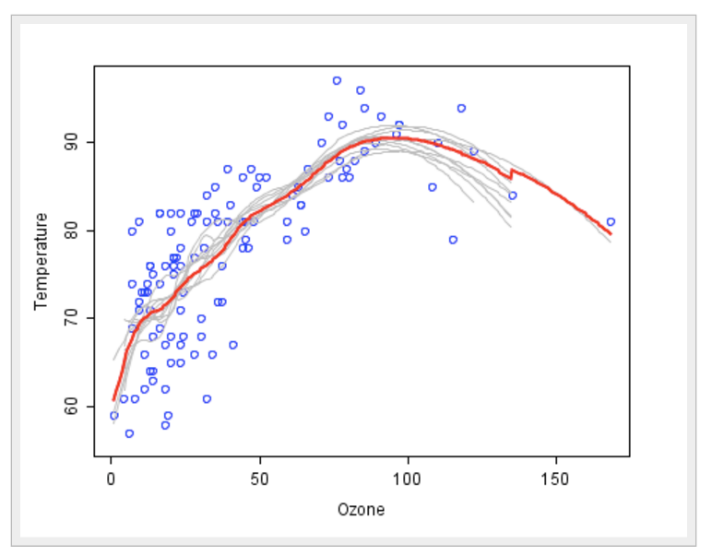
Introduction to Ensemble Classification (Random Forest – Breiman, 2001) https://citizennet.com/blog/2012/11/10/random-forests-ensembles-and-performance-metrics/

Slide 15
Introduction to Ensemble Classification
More Intuition:
Given 3 weak classifiers – e.g. .60 correct
Using Binomial Distribution:
Probability >= 2 Correct: (.6)(.6)(.6) + 3(.6)(.6)(.4) = (.36)(1.8) = .648
Probability with 105 such classifiers > .993 (http://vassarstats.net/textbook/ch5apx.html )

Slide 16
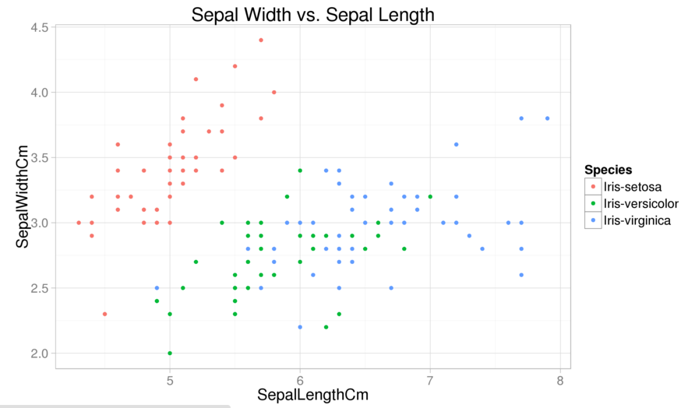
Classic Fisher Iris Data

Slide 17
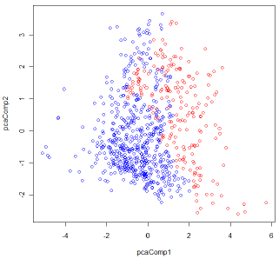
Ensemble Classification The Challenge is to be able to “classify” a new member, hence to separate the classes
Blue Dots are Non-Diabetic, Red are Diabetic

Slide 18
Introduction to Ensemble Classification
The Preceding assumes repeating the same learner. Of course we could use:
Different learning algorithms or different parameters
Data sets with different features or variables
Different weights on the data (Boosting)
Other combinations.

Slide 19
Introduction to Ensemble Classification (Bootstrap Aggregation – Bagging)
Repeated, random resampling of the training data
Bootstrap = Draw N items from Dataset, with replacement
Bagging =
Train M learners on M Bootstrap Samples
Combine outputs by voting
Result: Decreases Variance in results due to individual algorithms whose output can change dramatically when data is slightly different (i.e. unstable algorithms). Hence decreases error.

Slide 20
Introduction to Ensemble Classification (Bootstrap Aggregation – Bagging)
Given a data set D of size n
For i = 1 to M
Draw a sample of size m < n from D, uniformly and with replacement
Train a classifier C_{i}
Final classifier is a vote of C₁ to C_{M}

Slide 21
Introduction to Ensemble Classification (Boosting)
Starting with a “weak” learner, i.e. one which is more accurate than “random”
Best known algorithm is Adaboost developed at at&t Labs by Freund & Shapire in 1996
First large scale test on classifying bus/res in Call Detail Records, (Drucker, Cortes) 1996.
Technique:
Instead of resampling, reweight samples
At each iteration, a new classifier is learned and the examples are reweighted to focus learning on examples that the most recent classifier got wrong.
Final classifier based on weighted vote.

Slide 22
Introduction to Ensemble Classification (Adaptive Boosting - Adaboost)
Given a data set D of size N
Let M = the number of classifiers to be used
Set same weight for all examples (e.g. 1/N or 1)
For i = 1 to M
Train a classifier C_{i}
Increase the weight of the misclassified examples in C_{i}
Final classifier is a weighted combination of C₁ to C_{M} (generally weighted according to performance on training set. Many variants of weights and combinations).

Slide 23
Introduction to Ensemble Classification (AdaBoost Algorithm)
Let the dependent variable, Y = {-1,1}
Given a dataset D, draw N examples and weight each example with the same weight. Therefore the weight of the ith example, normalized, is D_{i} = W_{i} / Sum (W_{i} ). In this case W_{i} / N.
For j = 1 to M
Select a classifier “h” ( e.g. C4.5, logit, NB) and train the data with the given weights D_{i}
Sum D_{i} for all examples where the predicted value and the true value are not equal. This is the classifier’s error for the jth iteration (Error = Σ (D_{i} |Y(predicted) ≠ h_{j} (x_{i} )).

Slide 24
Introduction to Ensemble Classification (AdaBoost)
Continued
Set a(j) = (1/2)*ln((1-error(j)/error(j)). Note if error >1/2 ((1-error)/error)) <1, else >1.
Set W_{i} (j+1) = D_{i} (j) * exp [-a(j)* Y_{i} * h_{j} (x_{i} )]
Normalize new weights: D_{i} (j+1)= W_{i} (j+1)/ Sum (W_{i} (j+1))
End Loop
Calculate Classification for x.
H(x) = sign (Σ a(j)* h_{j} (x )) over all j
(Note: In R see “adabag”, in SAS a macro is required). (Python: class - http://scikit-learn.org/stable/modules/generated/sklearn.ensemble.AdaBoostClassifier.html

Slide 25
Introduction to Ensemble Classification (AdaBoost)
Some properties of Adaboost:
A linear classifier
Output converges to the log of the likelihood ratio
Good generalization properties
Uses a principled strategy (minimization of upper bound for empirical error) for selection
Produces a sequence of successively more complex classifiers.

Slide 26
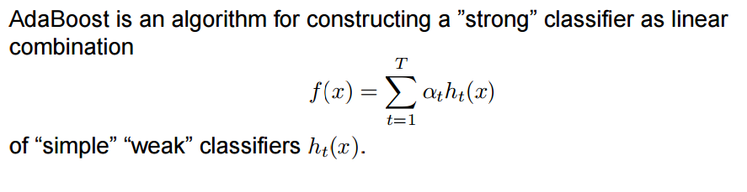
Introduction to Ensemble Classification (AdaBoost: Math one more time) http://www.robots.ox.ac.uk/~az/lectures/cv/adaboost_matas.pdf

Slide 27
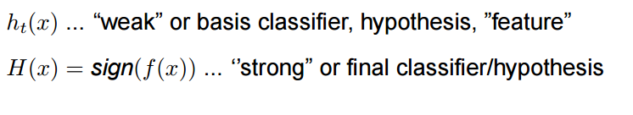
Introduction to Ensemble Classification (AdaBoost: Math one more time) http://www.robots.ox.ac.uk/~az/lectures/cv/adaboost_matas.pdf

Slide 28
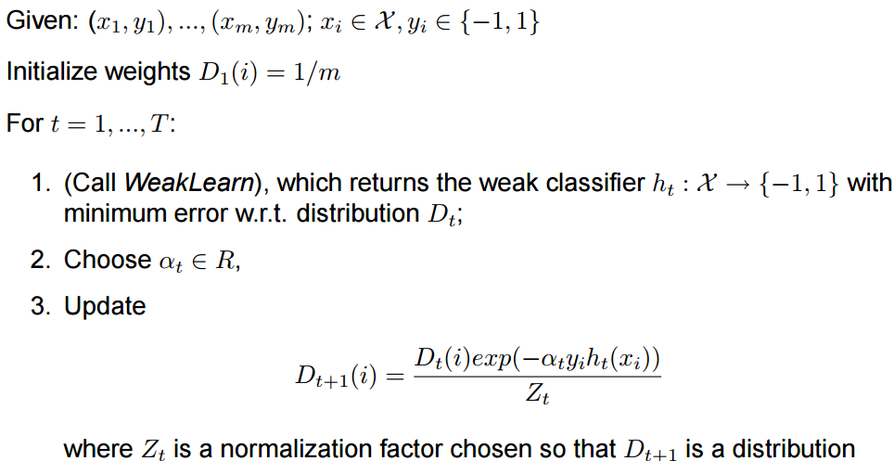
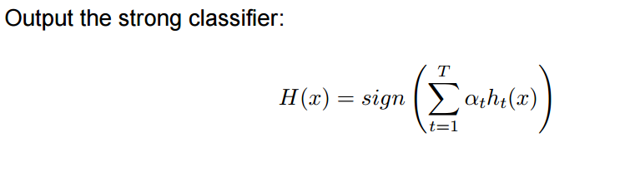
Introduction to Ensemble Classification (AdaBoost: Math one more time) http://www.robots.ox.ac.uk/~az/lectures/cv/adaboost_matas.pdf

Slide 29
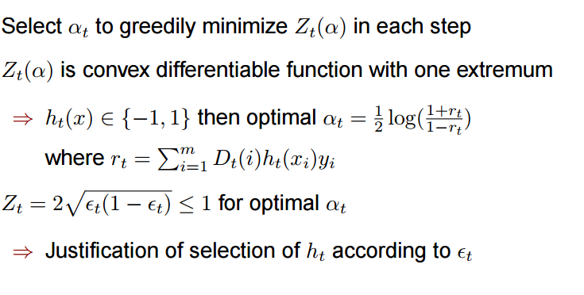
Introduction to Ensemble Classification (AdaBoost: Math one more time) http://www.robots.ox.ac.uk/~az/lectures/cv/adaboost_matas.pdf
Recall in previous notation: Set a(j) = (1/2)*ln((1-error(j)/error(j)). Note if error >1/2 ((1-error)/error)) <1, else >1.

Slide 30
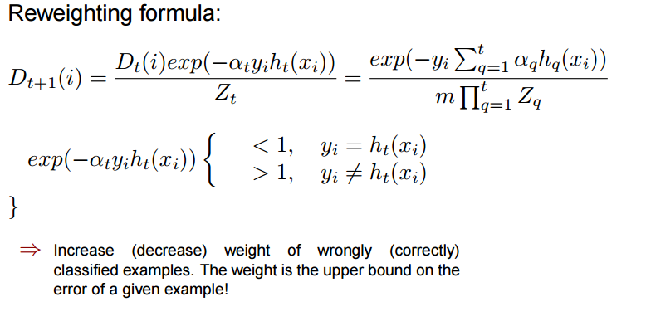
Introduction to Ensemble Classification (AdaBoost: Math one more time) http://www.robots.ox.ac.uk/~az/lectures/cv/adaboost_matas.pdf

Slide 31
Introduction to Ensemble Classification (AdaBoost: Math one more time) http://www.robots.ox.ac.uk/~az/lectures/cv/adaboost_matas.pdf
Nice Summary of Adaboost
Page 22

Slide 32
Adaboost – a Toy Example From a talk by Freund and Schapire which can be found in many locations including: http://www.di.unipi.it/~cardillo/AA0304/fabio/boosting.pdf

Slide 33
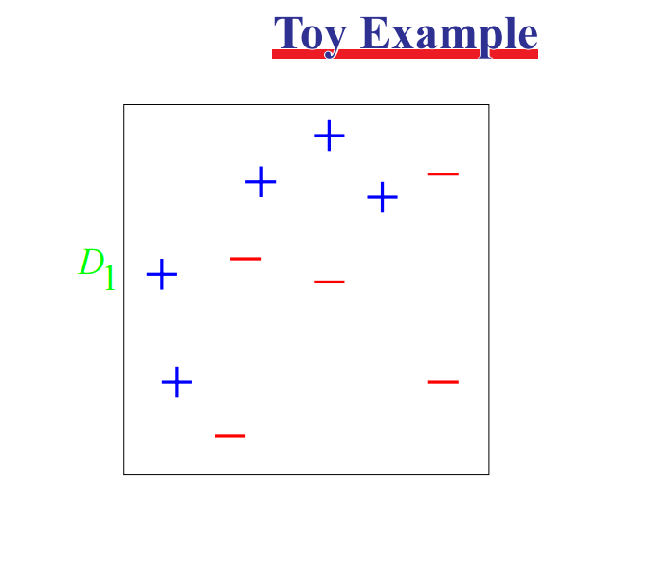
Adaboost – a Toy Example From a talk by Freund and Schapire which can be found in many locations including: http://www.di.unipi.it/~cardillo/AA0304/fabio/boosting.pdf

Slide 34
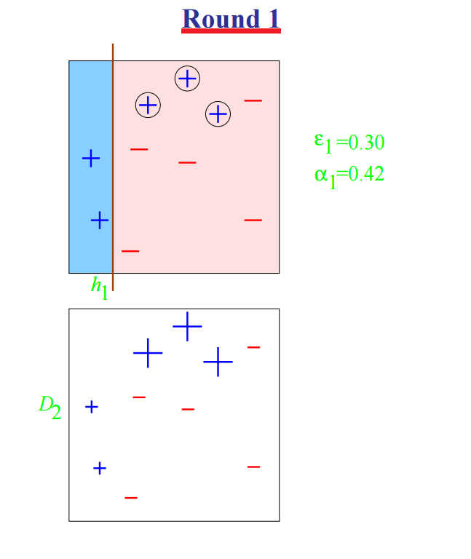
Adaboost – a Toy Example From a talk by Freund and Schapire which can be found in many locations including: http://www.di.unipi.it/~cardillo/AA0304/fabio/boosting.pdf

Slide 35
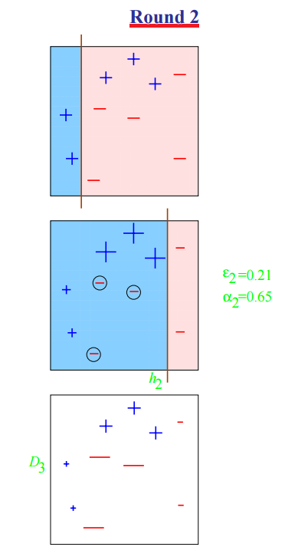
Adaboost – a Toy Example From a talk by Freund and Schapire which can be found in many locations including: http://www.di.unipi.it/~cardillo/AA0304/fabio/boosting.pdf

Slide 36
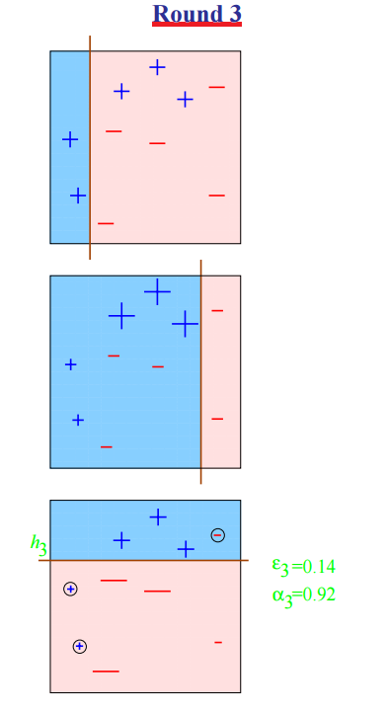
Adaboost – a Toy Example From a talk by Freund and Schapire which can be found in many locations including: http://www.di.unipi.it/~cardillo/AA0304/fabio/boosting.pdf

Slide 37
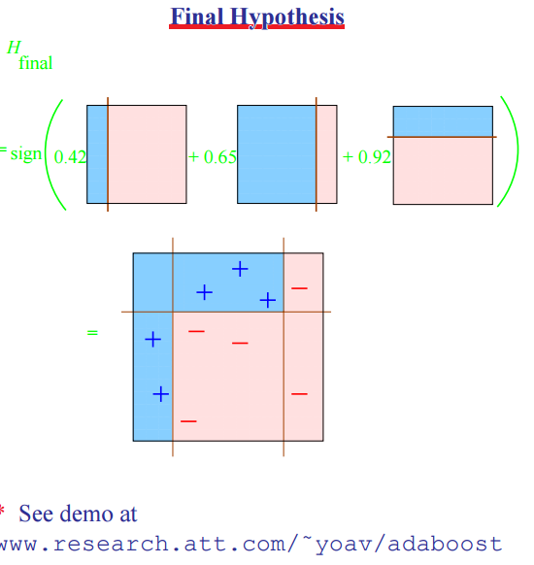
Adaboost – a Toy Example From a talk by Freund and Schapire which can be found in many locations including: http://www.di.unipi.it/~cardillo/AA0304/fabio/boosting.pdf

Slide 38
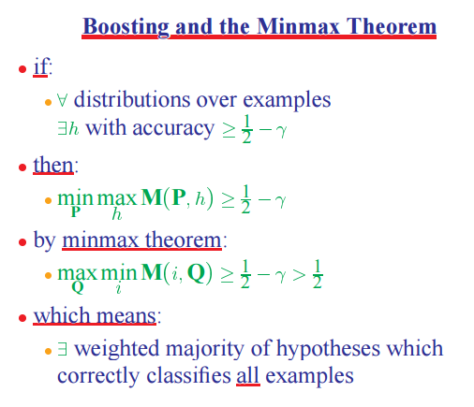
Adaboost – a Toy Example From a talk by Freund and Schapire which can be found in many locations including: http://www.di.unipi.it/~cardillo/AA0304/fabio/boosting.pdf

Slide 39
Performance of Adaboost Prof. Carla P. Gomes gomes@cs.cornell.edu
Learner = Hypothesis = Classifier
Weak Learner: < 50% error over any distribution
M number of hypothesis in the ensemble.
If the input learning is a Weak Learner, then ADABOOST will return a
hypothesis that classifies the training data perfectly for a large enough M,
boosting the accuracy of the original learning algorithm on the training
data.
Strong Classifier: thresholded linear combination of weak learner outputs.

Slide 40
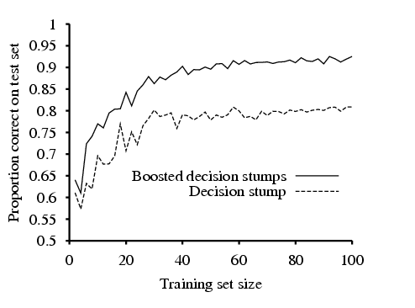
Restaurant Data Prof. Carla P. Gomes gomes@cs.cornell.edu
Decision stump: decision trees with just one test at the root.

Slide 41
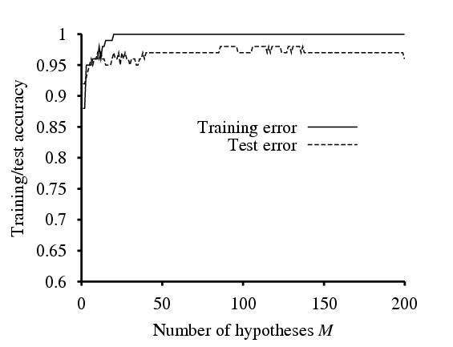
Restaurant Data Prof. Carla P. Gomes gomes@cs.cornell.edu
Training error reaches zero for M=20 (as predicted by the theorem),
and remains zero as more stumps are added to the ensemble.
Test performance continues to increase after training set
error has reached zero.
Boosting approximates
Bayesian Learning, which can be shown
to be an optimal learning algorithm.

Slide 42
Summary of Classification
Purpose: Train on a supervised dataset so that new entries can be “classified” into one of two different group. Techniques for more than two groups available.
Techniques:
Linear Discriminant Analysis – One of the First Techniques
Assumptions:
Multivariate Normality of Predictors
Correlation of Predictors the same across classes
Sensitive to Outliers
Logistic Regression – One of Most Widely Used Techniques Across Many Fields. In some fields the Standard.
Based on a linear function of Odds.
Directly estimates the parameters of P(Y|X).
Typically a good option if there is a lot of noise, moderate dimensionality, and a reasonable amount of data.
Provides a Probabilistic Classifier.
(Continued)

Slide 43
Summary of Classification (Continued)
Purpose: Train on a supervised dataset so that new entries can be “classified” into one of two different group. Techniques for more than two groups available.
Techniques:
(Gaussian) Naïve Bayesian – Simple and Often Very Accurate Classifier
Uses all variables, but treats them individually
Assumes that Independent Variables are Conditionally Independent given Y.
Based on Bayes Rule of Conditional Probability
Directly estimates the parameters of P(Y) and P(X|Y)
GNB and Logistic Regression Asymptotically Converge to Same Classifier.
Other Options:
Support Vector Machines (SVM)
Generally work well with very high dimensions and relatively little noise
Use added dimensions to find separating hyperplane
Use only points near the margin (support vectors), unlike Logit.
Geographical Intuition.

Slide 44
Summary of Classification Cross Validation
Create a K-Fold Partition of your Dataset D.
For each of K experiments, use K-1 Folds for training and the remaining Fold for testing. For example, if K = 4:
Experiment 1
F1
F2
F3
F4
Experiment 2
F1
F2
F3
F4
Experiment 3
F1
F2
F3
F4
Experiment 4
F1
F2
F3
F4
True error rate estimate is: (1/K)Σ (E_{i} ) = Mean of individual error rates.
Available in SAS - PROC GLMSELECT; several libraries in R, e.g. “boot” “DAAG” “Design”. Python: http://scikit-learn.org/stable/modules/cross_validation.html

